Slide 1


Slide 2
DEEP LEARNING COURSE
FALL 2024
Usman Khan, PhD

Slide 3
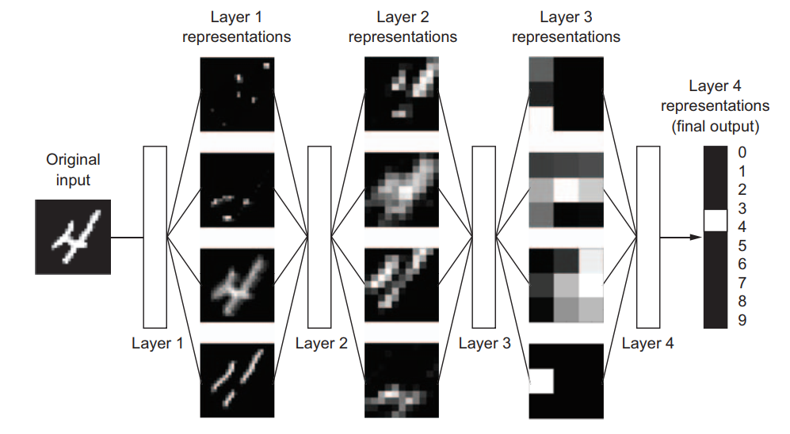
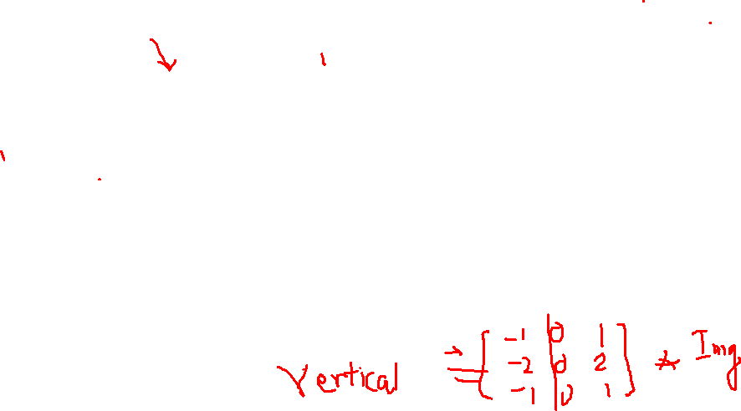
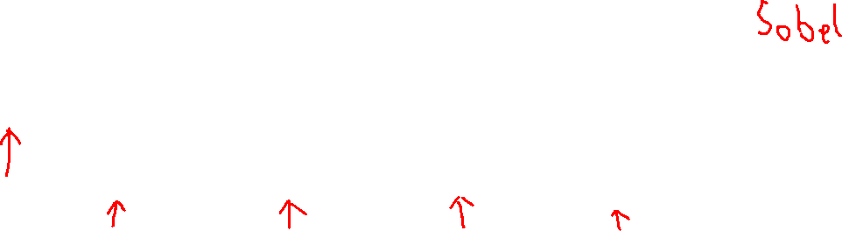
SEQUENCE OF FILTERS THAT LEAD TO THE CLASSIFICATION

Slide 4
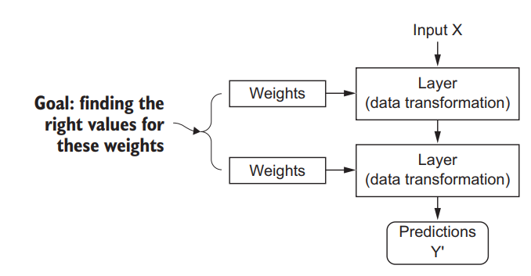
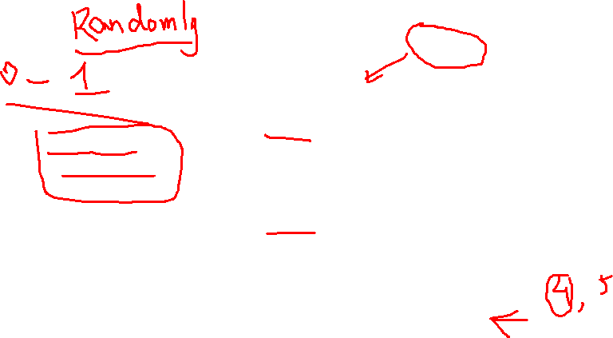
WHAT IS THE ULTIMATE GOAL

Slide 5
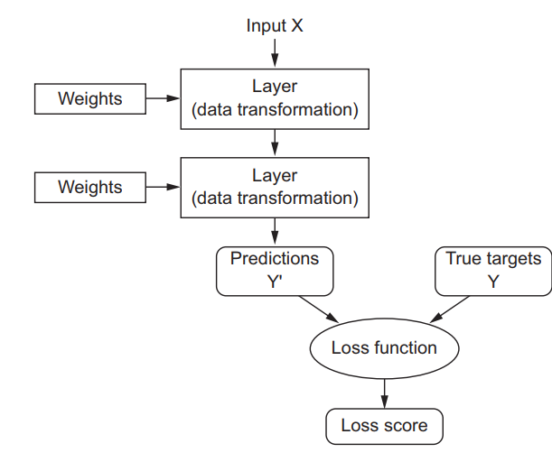
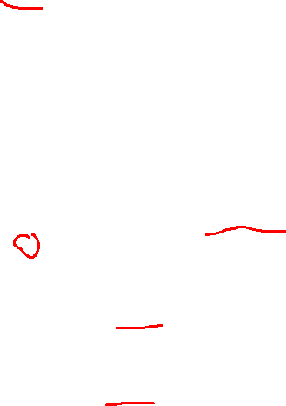
THE OBJECTIVE FUNCTION

Slide 6
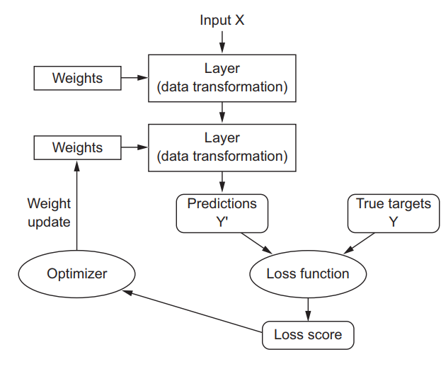
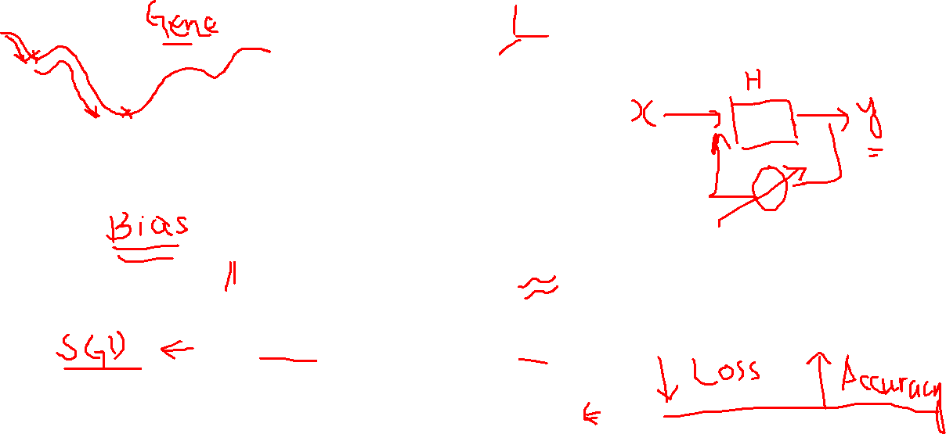
ADJUSTMENT OF WEIGHTS BY THE OPTIMIZER
Notes:
Initially, the weights of the network are assigned random values, so the network merely implements a series of random transformations. Naturally, its output is far from what it should ideally be, and the loss score is accordingly very high. But with every example the network processes, the weights are adjusted a little in the correct direction, and the loss score decreases. This is the training loop, which, repeated a sufficient number of times (typically tens of iterations over thousands of examples), yields weight values that minimize the loss function.

Slide 7
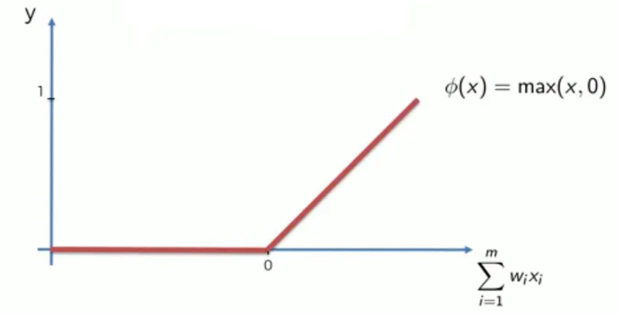
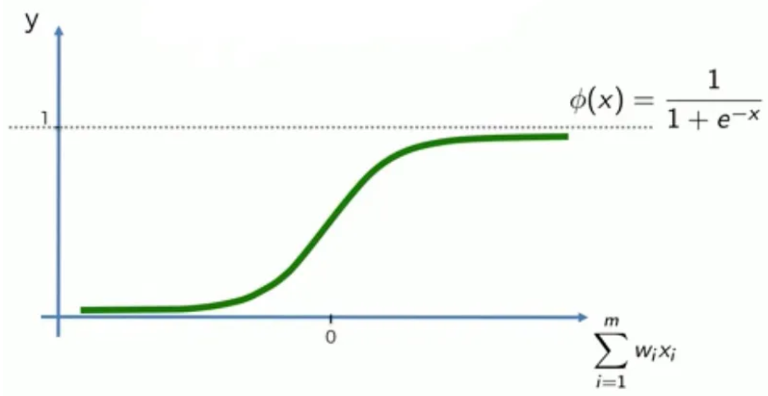
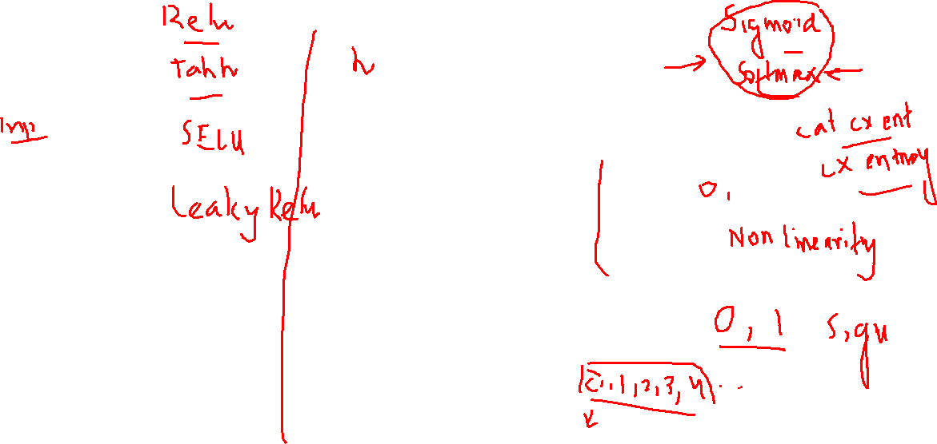
HIDDEN LAYERS ACTIVATION FUNCTION
Output Layer
Input Layer
Hidden Layer

Slide 8
A SIMPLE EXAMPLE OF FORWARD & BACKWARD PROPAGATION OF A NEURAL NETWORK
Mathematical Intuition
Let's consider a simple neural network with one input, one hidden layer with one neuron, and one output neuron.
Input: x
Hidden layer weight: w1
Hidden layer bias: b1
Output layer weight: w2
Output layer bias: b2
Activation function: sigmoid (σ)
Notes:
Initially, the weights of the network are assigned random values, so the network merely implements a series of random transformations. Naturally, its output is far from what it should ideally be, and the loss score is accordingly very high. But with every example the network processes, the weights are adjusted a little in the correct direction, and the loss score decreases. This is the training loop, which, repeated a sufficient number of times (typically tens of iterations over thousands of examples), yields weight values that minimize the loss function.

Slide 9




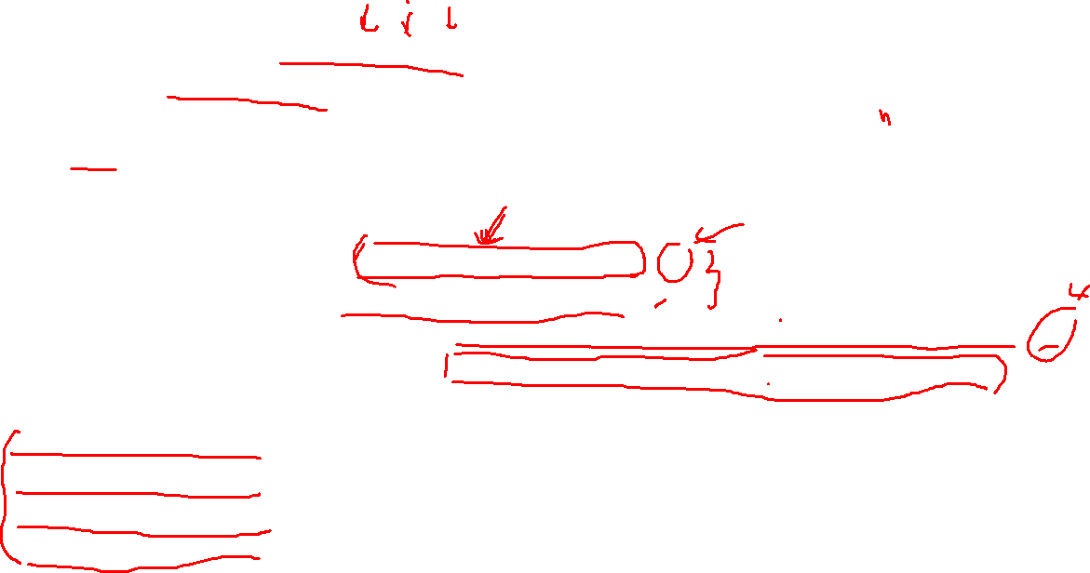



A SIMPLE EXAMPLE OF FORWARD & BACKWARD PROPAGATION OF A NEURAL NETWORK
Forward pass:
Hidden layer output: h = σ(w1 * x + b1)
Output: y = σ(w2 * h + b2)
Loss function (MSE):
L = (y - t)² (where t is the target output)
Backward pass (gradient calculation):
∂L/∂y = 2(y - t)
∂L/∂w2 = ∂L/∂y * ∂y/∂w2 = 2(y - t) * σ'(w2 * h + b2) * h
∂L/∂b2 = ∂L/∂y * ∂y/∂b2 = 2(y - t) * σ'(w2 * h + b2)
∂L/∂w1 = ∂L/∂y * ∂y/∂h * ∂h/∂w1 = 2(y - t) * σ'(w2 * h + b2) * w2 * σ'(w1 * x + b1) * x
∂L/∂b1 = ∂L/∂y * ∂y/∂h * ∂h/∂b1 = 2(y - t) * σ'(w2 * h + b2) * w2 * σ'(w1 * x + b1)
Weight and bias update:
w2 = w2 - α * ∂L/∂w2
b2 = b2 - α * ∂L/∂b2
w1 = w1 - α * ∂L/∂w1
b1 = b1 - α * ∂L/∂b1
$$w_{1}$$
$$w_{2}$$
$$x$$
$$h$$
$$y$$
$$b_{2}$$
$$b_{1}$$
(where α is the learning rate)
Notes:
Initially, the weights of the network are assigned random values, so the network merely implements a series of random transformations. Naturally, its output is far from what it should ideally be, and the loss score is accordingly very high. But with every example the network processes, the weights are adjusted a little in the correct direction, and the loss score decreases. This is the training loop, which, repeated a sufficient number of times (typically tens of iterations over thousands of examples), yields weight values that minimize the loss function.

Slide 10
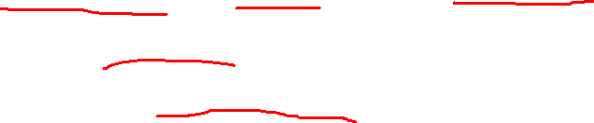
A SIMPLE EXAMPLE OF FORWARD & BACKWARD PROPAGATION OF A NEURAL NETWORK
Key Points
Backpropagation is a chain rule application to compute gradients.
The gradients are used to update weights and biases to minimize the loss function.
The choice of activation function, loss function, and optimization algorithm can significantly impact the training process.
For larger neural networks, matrix operations can be used to efficiently compute gradients.
Notes:
Initially, the weights of the network are assigned random values, so the network merely implements a series of random transformations. Naturally, its output is far from what it should ideally be, and the loss score is accordingly very high. But with every example the network processes, the weights are adjusted a little in the correct direction, and the loss score decreases. This is the training loop, which, repeated a sufficient number of times (typically tens of iterations over thousands of examples), yields weight values that minimize the loss function.

Slide 11

C++ Implementation Training Using Back Propagation
// Tutorial_1_BackProp.cpp : Defines the entry point for the application.
//
#include <iostream>
#include <cmath>
using namespace std;
// Sigmoid activation function
double sigmoid(double x) {
return 1.0 / (1.0 + exp(-x));
}
Notes:
Initially, the weights of the network are assigned random values, so the network merely implements a series of random transformations. Naturally, its output is far from what it should ideally be, and the loss score is accordingly very high. But with every example the network processes, the weights are adjusted a little in the correct direction, and the loss score decreases. This is the training loop, which, repeated a sufficient number of times (typically tens of iterations over thousands of examples), yields weight values that minimize the loss function.

Slide 12
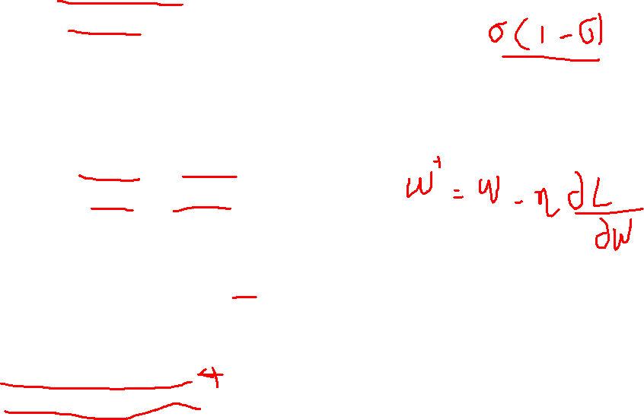
C++ Implementation Training Using Back Propagation
// Derivative of sigmoid function
double sigmoid_prime(double x) {
return sigmoid(x) * (1.0 - sigmoid(x));
}
int main() {
// Initialize weights and biases
double w1 = 0.1, w2 = 0.2;
double b1 = 0.3, b2 = 0.4;
// Learning rate
double learning_rate = 0.1;
// Training data
double input = 0.2;
double target = 0.8;
Notes:
Initially, the weights of the network are assigned random values, so the network merely implements a series of random transformations. Naturally, its output is far from what it should ideally be, and the loss score is accordingly very high. But with every example the network processes, the weights are adjusted a little in the correct direction, and the loss score decreases. This is the training loop, which, repeated a sufficient number of times (typically tens of iterations over thousands of examples), yields weight values that minimize the loss function.

Slide 13
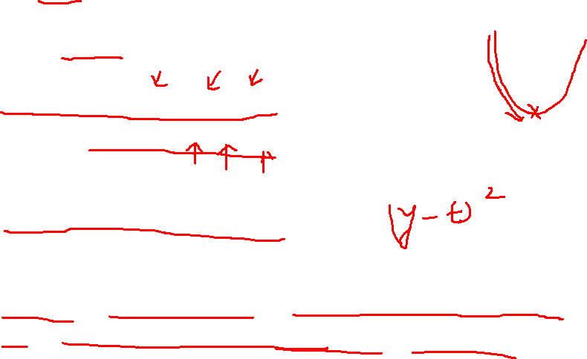
C++ Implementation Training Using Back Propagation
// Number of epochs
int epochs = 10000;
for (int i = 0; i < epochs; ++i) {
// Forward pass
double h = sigmoid(w1 * input + b1);
double output = sigmoid(w2 * h + b2);
// Calculate error
double error = pow(target - output, 2);
// Backward pass
double d_output = (target - output) * sigmoid_prime(w2 * h + b2);
double d_h = w2 * d_output * sigmoid_prime(w1 * input + b1);
Notes:
Initially, the weights of the network are assigned random values, so the network merely implements a series of random transformations. Naturally, its output is far from what it should ideally be, and the loss score is accordingly very high. But with every example the network processes, the weights are adjusted a little in the correct direction, and the loss score decreases. This is the training loop, which, repeated a sufficient number of times (typically tens of iterations over thousands of examples), yields weight values that minimize the loss function.

Slide 14

C++ Implementation Training Using Back Propagation
// Update weights and biases
w2 += learning_rate * d_output * h;
b2 += learning_rate * d_output;
w1 += learning_rate * d_h * input;
b1 += learning_rate * d_h;
// Print error every 1000 epochs
if (i % 1000 == 0) {
std::cout << "Epoch " << i << ": Error = " << error << std::endl;
}
}
std::cout << "Final weights and biases:\n";
std::cout << "w1 = " << w1 << ", w2 = " << w2 << std::endl;
std::cout << "b1 = " << b1 << ", b2 = " << b2 << std::endl;
return 0;
}
Notes:
Initially, the weights of the network are assigned random values, so the network merely implements a series of random transformations. Naturally, its output is far from what it should ideally be, and the loss score is accordingly very high. But with every example the network processes, the weights are adjusted a little in the correct direction, and the loss score decreases. This is the training loop, which, repeated a sufficient number of times (typically tens of iterations over thousands of examples), yields weight values that minimize the loss function.

Slide 15
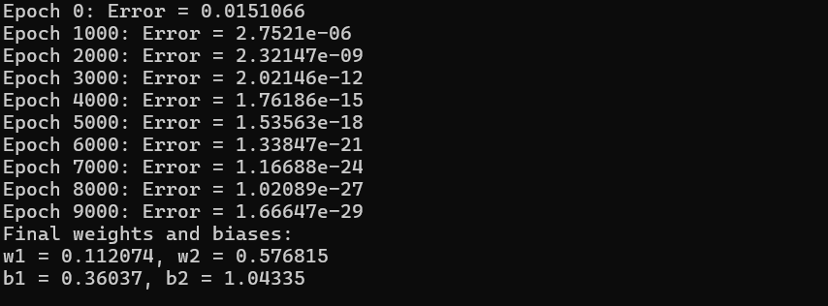
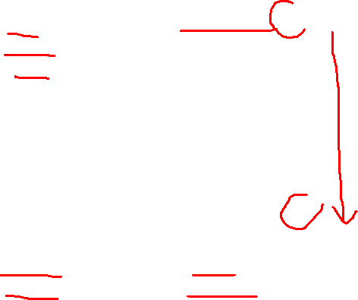
C++ Implementation Training Using Back Propagation
Notes:
Initially, the weights of the network are assigned random values, so the network merely implements a series of random transformations. Naturally, its output is far from what it should ideally be, and the loss score is accordingly very high. But with every example the network processes, the weights are adjusted a little in the correct direction, and the loss score decreases. This is the training loop, which, repeated a sufficient number of times (typically tens of iterations over thousands of examples), yields weight values that minimize the loss function.

Slide 16
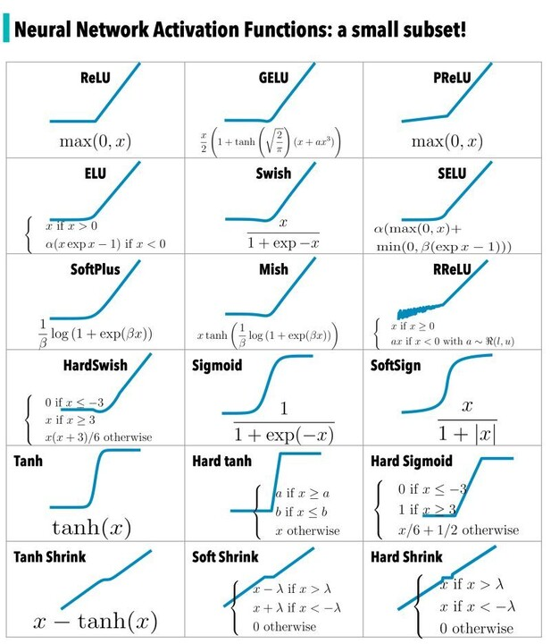
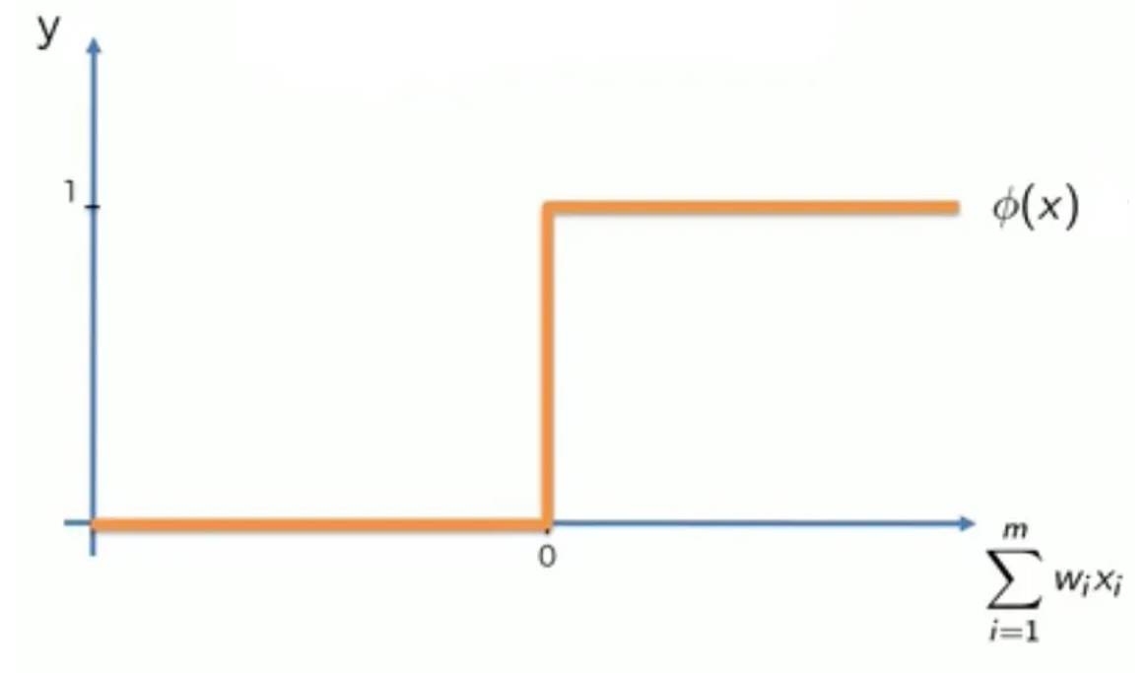
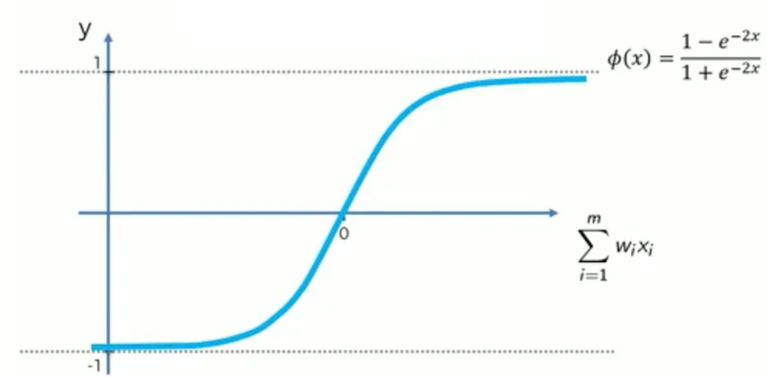
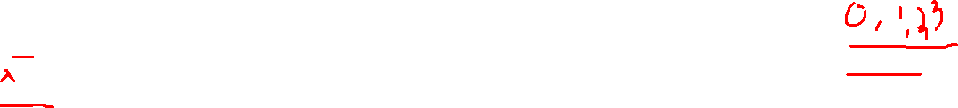
ACTIVATION FUNCTIONS
Threshold Activation Fn
Sigmoid Activation Fn
Rectified Linear Unit
Hyperbolic Tangent Fn

Slide 17

IMPLEMENTING MLP WITH KERAS
Lets learn through a simple hello world tutorial
Lets tackle Fashion MNIST, which is a drop-in replacement of MNIST.
It has the exact same format as MNIST (70,000 grayscale images of 28 × 28 pixels each, with 10 classes), but the images represent fashion items rather than handwritten digits, so each class is more diverse, and the problem turns out to be significantly more challenging than MNIST
A simple linear model reaches about 92% accuracy on MNIST, but only about 83% on Fashion MNIST

Slide 18
HOME ASSIGNMENT – CREATE KAGGLE ACCOUNT
1. Create a Kaggle Account
Go to kaggle.com and sign up with Google, Facebook, or Email.
Complete the setup and verify your email.
2. Navigate the Kaggle Interface
Competitions, Datasets, Kernels, Courses: Explore and use resources.
Start a New Notebook: Go to Kernels > Notebooks > New Notebook.
3. Setup Notebook Environment
Choose Python as the language and enable GPU in Settings for accelerated tasks.
4. Verify the Tensorflow installation
import tensorflow as tf
print(tf.__version__)
5. !pip install tensorflow==2.x.x
Notes:
Initially, the weights of the network are assigned random values, so the network merely implements a series of random transformations. Naturally, its output is far from what it should ideally be, and the loss score is accordingly very high. But with every example the network processes, the weights are adjusted a little in the correct direction, and the loss score decreases. This is the training loop, which, repeated a sufficient number of times (typically tens of iterations over thousands of examples), yields weight values that minimize the loss function.

Slide 19
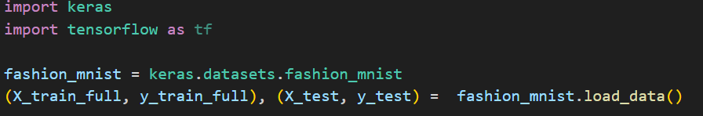
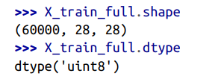

IMPLEMENTING MLP WITH KERAS
Note that the dataset is already split into a training set and a test set, but there is no validation set, so we’ll create one now. Additionally, since we are going to train the neural network using Gradient Descent, we must scale the input features. For simplic‐ ity, we’ll scale the pixel intensities down to the 0–1 range by dividing them by 255.0 (this also converts them to floats):

Slide 20
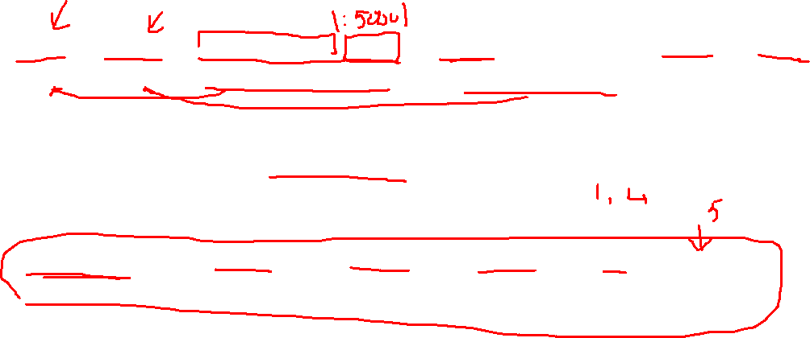
IMPLEMENTING MLP WITH KERAS
Note that the dataset is already split into a training set and a test set, but there is no validation set, so we’ll create one now. Additionally, since we are going to train the neural network using Gradient Descent, we must scale the input features. For simplicity, we’ll scale the pixel intensities down to the 0–1 range by dividing them by 255.0
With MNIST, when the label is equal to 5, it means that the image represents the handwritten digit 5. Easy. For Fashion MNIST, however, we need the list of class names to know what we are dealing with:

Slide 21

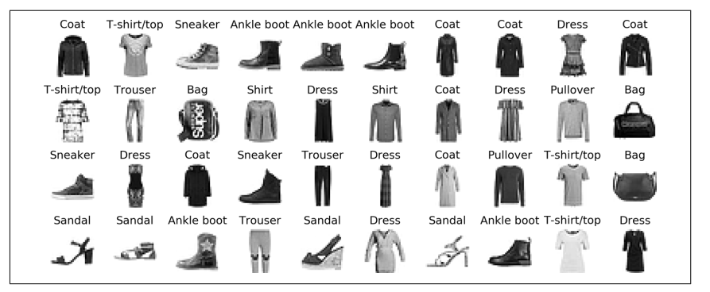
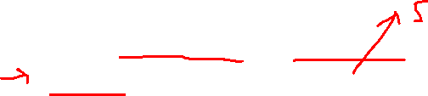
IMPLEMENTING MLP WITH KERAS
For example, the first image in the training set represents a coat
Samples from Fashion MNIST

Slide 22
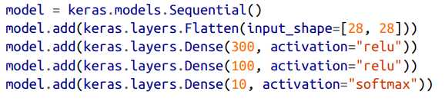
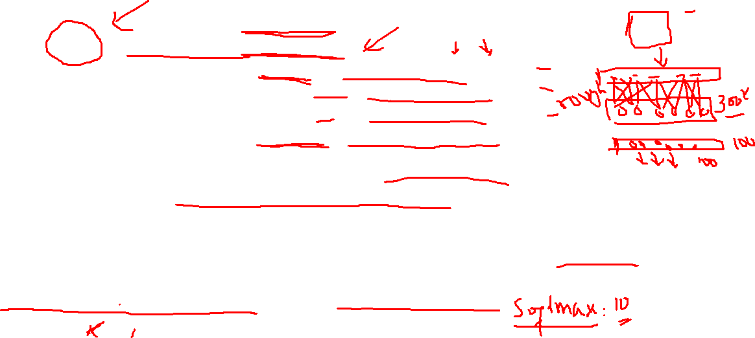
IMPLEMENTING MLP WITH KERAS
Now let’s build the neural network! Here is a classification MLP with two hidden layers:
The first line creates a Sequential model. This is the simplest kind of Keras model for neural networks that are just composed of a single stack of layers connected sequentially. This is called the Sequential API.
Next, we build the first layer and add it to the model. It is a Flatten layer whose role is to convert each input image into a 1D array. This layer does not have any parameters; it is just there to do some simple preprocessing. Since it is the first layer in the model, you should specify the input_shape, which doesn’t include the batch size, only the shape of the instances. Alternatively, you could add a keras.layers.InputLayer as the first layer, setting input_shape=[28,28].

Slide 23
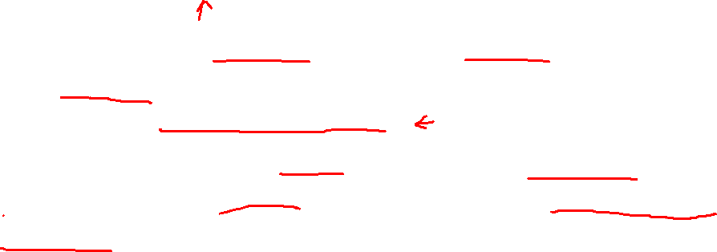
IMPLEMENTING MLP WITH KERAS
Now let’s build the neural network! Here is a classification MLP with two hidden layers:
Next we add a Dense hidden layer with 300 neurons. It will use the ReLU activation function. Each Dense layer manages its own weight matrix, containing all the connection weights between the neurons and their inputs. It also manages a vector of bias terms (one per neuron).
Then we add a second Dense hidden layer with 100 neurons, also using the ReLU activation function
Finally, we add a Dense output layer with 10 neurons (one per class), using the softmax activation function (because the classes are exclusive).

Slide 24
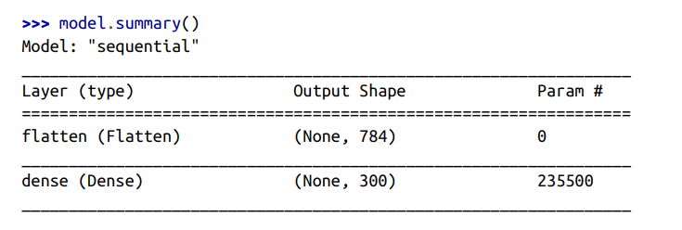
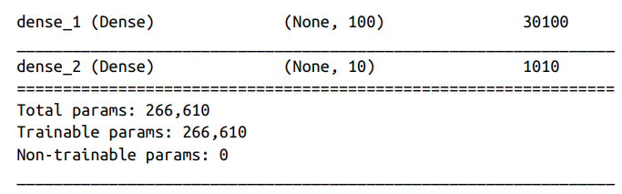
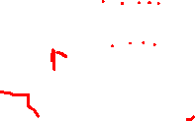
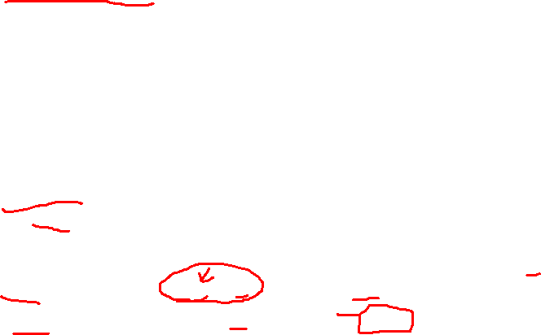
IMPLEMENTING MLP WITH KERAS
The model’s summary() method displays all the model’s layers, including each layer’s name (which is automatically generated unless you set it when creating the layer), its output shape (None means the batch size can be anything), and its number of parameters. The summary ends with the total number of parameters, including trainable and non-trainable parameters.

Slide 25
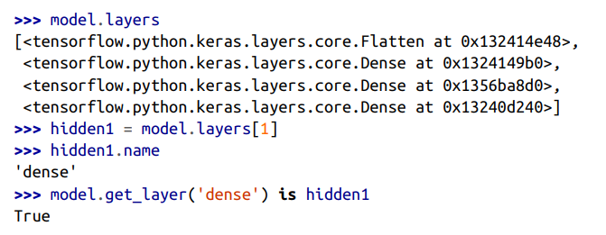

IMPLEMENTING MLP WITH KERAS
Note that Dense layers often have a lot of parameters. For example, the first hidden layer has 784 × 300 connection weights, plus 300 bias terms, which adds up to 235,500 parameters! This gives the model quite a lot of flexibility to fit the training data, but it also means that the model runs the risk of overfitting, especially when you do not have a lot of training data.
You can easily get a model’s list of layers, to fetch a layer by its index, or you can fetch it by name:

Slide 26
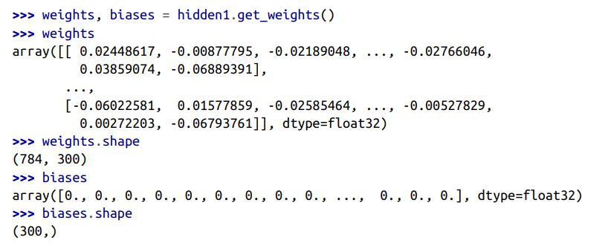
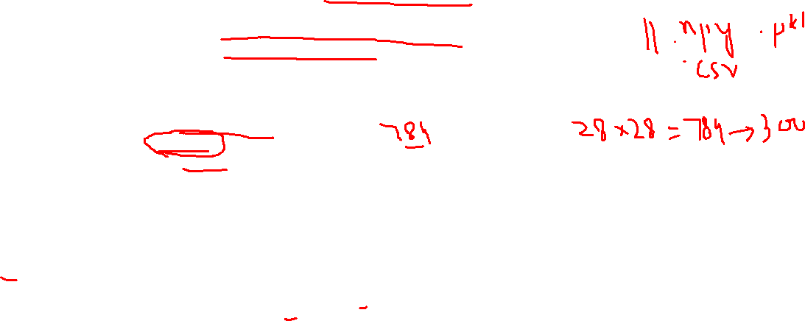
IMPLEMENTING MLP WITH KERAS
All the parameters of a layer can be accessed using its get_weights() and set_weights() methods. For a Dense layer, this includes both the connection weights and the bias terms.

Slide 27
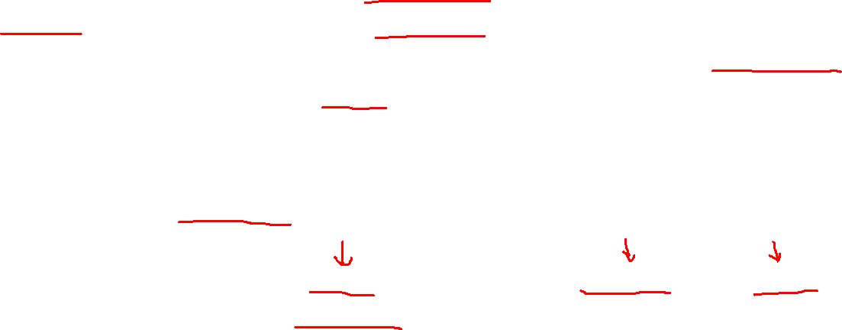
IMPLEMENTING MLP WITH KERAS
The shape of the weight matrix depends on the number of inputs. This is why it is recommended to specify the input_shape when creating the first layer in a Sequential model. However, if you do not specify the input shape, it’s OK: Keras will simply wait until it knows the input shape before it actually builds the model. This will happen either when you feed it actual data (e.g., during training), or when you call its build() method.
Until the model is really built, the layers will not have any weights, and you will not be able to do certain things (such as print the model summary or save the model). So, if you know the input shape when creating the model, it is best to specify it.
After a model is created, you must call its compile() method to specify the loss function and the optimizer to use. Optionally, you can specify a list of extra metrics to compute during training and evaluation:

Slide 28

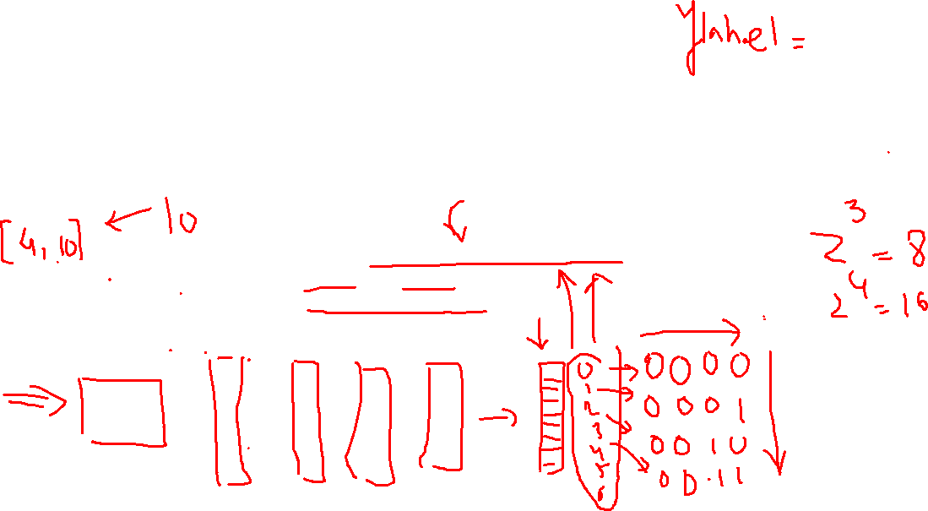
IMPLEMENTING MLP WITH KERAS
Using loss="sparse_categorical_crossentropy" is equivalent to using loss=keras.losses.sparse_categorical_crossentropy. Similarly, specifying optimizer="sgd" is equivalent to specifying optimizer=keras.optimizers.SGD(), and metrics=["accuracy"] is equivalent to metrics=[keras.metrics.sparse_categori cal_accuracy] (when using this loss).

Slide 29
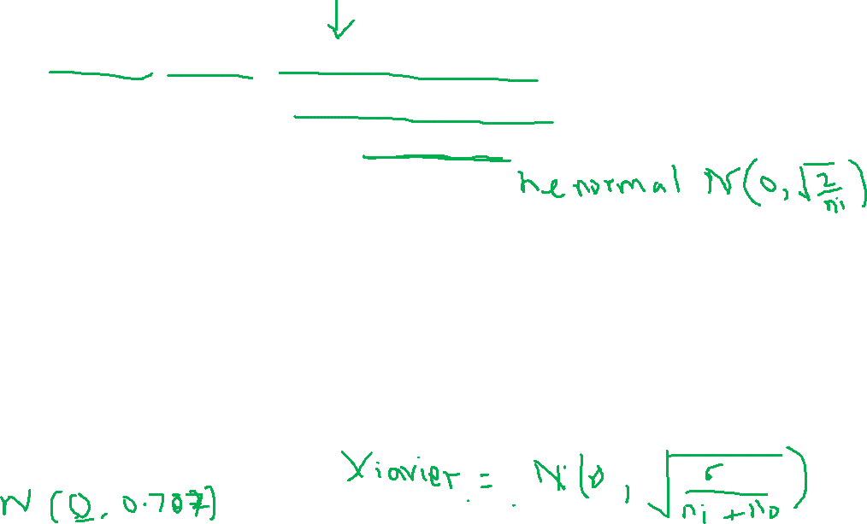
IMPLEMENTING MLP WITH KERAS
Notice that the Dense layer initialized the connection weights randomly (which is needed to break symmetry, as we discussed earlier), and the biases were initialized to zeros, which is fine. If you ever want to use a different initialization method, you can set kernel_initializer (kernel is another name for the matrix of connection weights) or bias_initializer when creating the layer.
The shape of the weight matrix depends on the number of inputs. This is why it is recommended to specify the input_shape when creating the first layer in a Sequential model. However, if you do not specify the input shape, it’s OK: Keras will simply wait until it knows the input shape before it actually builds the model. This will happen either when you feed it actual data (e.g., during training), or when you call its build() method. Until the model is really built, the layers will not have any weights, and you will not be able to do certain things (such as print the model summary or save the model). So, if you know the input shape when creating the model, it is best to specify it.

Slide 30
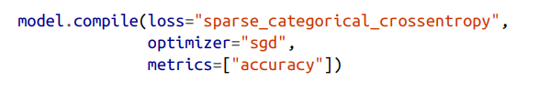
IMPLEMENTING MLP WITH KERAS
After a model is created, you must call its compile() method to specify the loss func‐ tion and the optimizer to use. Optionally, you can specify a list of extra metrics to compute during training and evaluation:
Using loss="sparse_categorical_crossentropy" is equivalent to using loss=keras.losses.sparse_categorical_crossentropy. Similarly, specifying optimizer="sgd" is equivalent to specifying optimizer=keras.optimizers.SGD(), and metrics=["accuracy"] is equivalent to metrics=[keras.metrics.sparse_categorical_accuracy] (when using this loss).

Slide 31
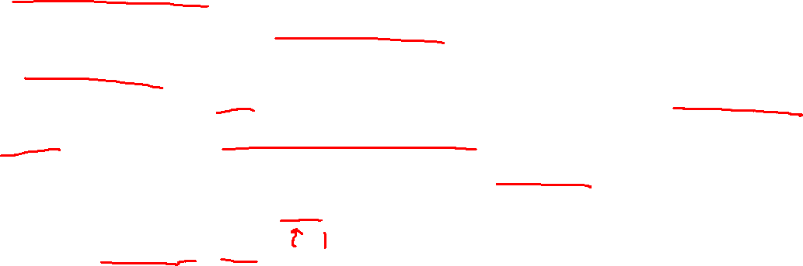
IMPLEMENTING MLP WITH KERAS
This code requires some explanation. First, we use the "sparse_categorical_cross entropy" loss because we have sparse labels (i.e., for each instance, there is just a target class index, from 0 to 9 in this case), and the classes are exclusive. If instead we had one target probability per class for each instance (such as one-hot vectors, e.g. [0., 0., 0., 1., 0., 0., 0., 0., 0., 0.] to represent class 3), then we would need to use the "categorical_crossentropy" loss instead. If we were doing binary classification (with one or more binary labels), then we would use the "sigmoid" (i.e., logistic) activation function in the output layer instead of the "softmax" activation function, and we would use the "binary_crossentropy" loss.
Regarding the optimizer, "sgd" means that we will train the model using simple Stochastic Gradient Descent. In other words, Keras will perform the backpropagation algorithm described earlier.
When using the SGD optimizer, it is important to tune the learning rate. So, you will generally want to use optimizer=keras.optimizers.SGD(lr=???) to set the learning rate, rather than optimizer="sgd", which defaults to learning_rate=0.01

Slide 32
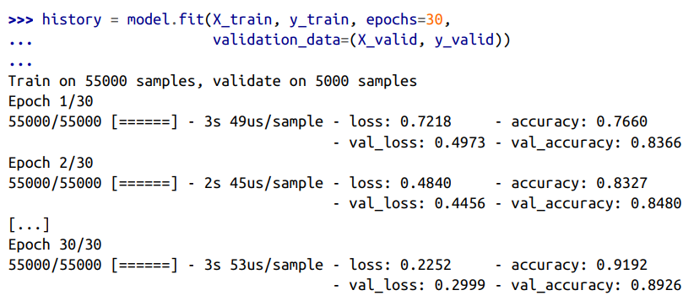
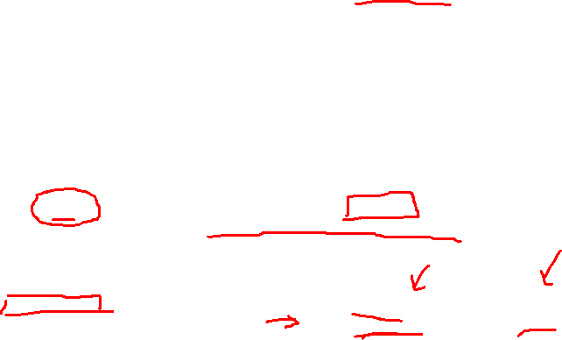
IMPLEMENTING MLP WITH KERAS
To start training the model we simply use model.fit command.
We pass it the input features (X_train) and the target classes (y_train), as well as the number of epochs to train (or else it would default to just 1, which would definitely not be enough to converge to a good solution). We also pass a validation set (this is optional). Keras will measure the loss and the extra metrics on this set at the end of each epoch, which is very useful to see how well the model really performs.

Slide 33

IMPLEMENTING MLP WITH KERAS
To start training the model we simply use model.fit command.
We pass it the input features (X_train) and the target classes (y_train), as well as the number of epochs to train (or else it would default to just 1, which would definitely not be enough to converge to a good solution). We also pass a validation set (this is optional). Keras will measure the loss and the extra metrics on this set at the end of each epoch, which is very useful to see how well the model really performs.
If the performance on the training set is much better than on the validation set, your model is probably overfitting the training set (or there is a bug, such as a data mismatch between the training set and the validation set).

Slide 34
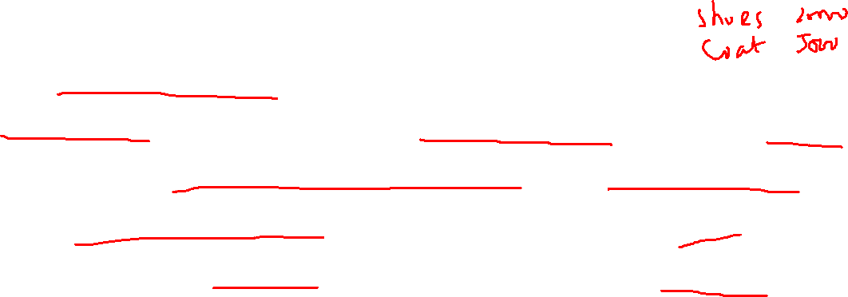
IMPLEMENTING MLP WITH KERAS
Instead of passing a validation set using the validation_data argument, you could set validation_split to the ratio of the training set that you want Keras to use for validation. For example, validation_split=0.1 tells Keras to use the last 10% of the data (before shuffling) for validation
If the training set was very skewed, with some classes being overrepresented and others underrepresented, it would be useful to set the class_weight argument when calling the fit() method, which would give a larger weight to underrepresented classes and a lower weight to overrepresented.
The fit() method returns a History object containing the training parameters (history.params), the list of epochs it went through (history.epoch), and most importantly a dictionary (history.history) containing the loss and extra metrics it measured at the end of each epoch on the training set and on the validation set

Slide 35
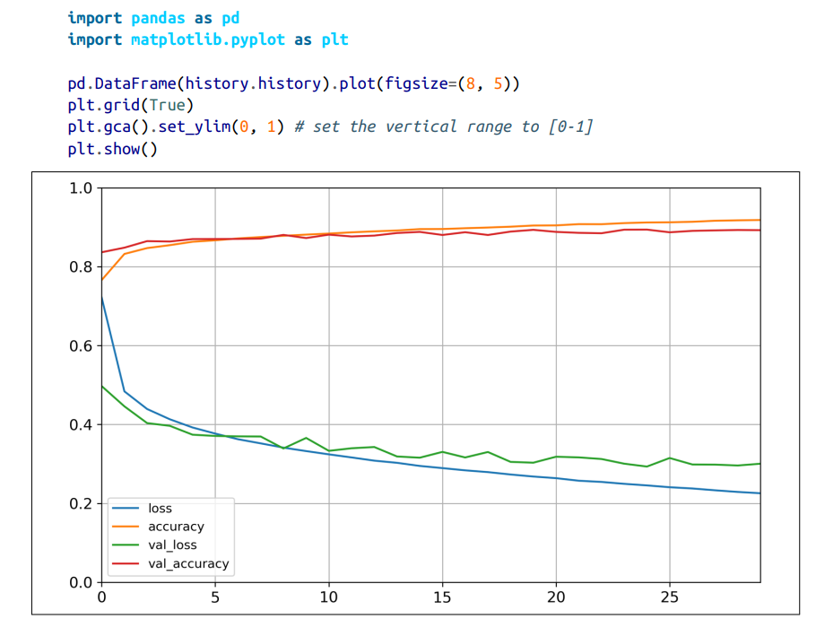
IMPLEMENTING MLP WITH KERAS
You can see that both the training accuracy and the validation accuracy steadily increase during training, while the training loss and the validation loss decrease.
Moreover, the validation curves are close to the training curves, which means that there is not too much overfitting.

Slide 36
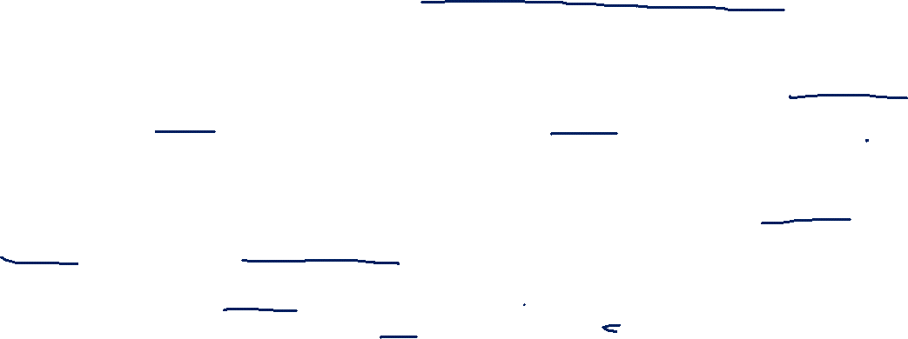
IMPLEMENTING MLP WITH KERAS
The training set performance ends up beating the validation performance, as is generally the case when you train for long enough. You can tell that the model has not quite converged yet, as the validation loss is still going down, so you should probably continue training.
It’s as simple as calling the fit() method again, since Keras just continues training where it left off (you should be able to reach close to 89% validation accuracy).
If you are not satisfied with the performance of your model, you should go back and tune the hyperparameters. The first one to check is the learning rate. If that doesn’t help, try another optimizer (and always retune the learning rate after changing any hyperparameter).
If the performance is still not great, then try tuning model hyper‐ parameters such as the number of layers, the number of neurons per layer, and the types of activation functions to use for each hidden layer. You can also try tuning other hyperparameters, such as the batch size (it can be set in the fit() method using the batch_size argument, which defaults to 32).

Slide 37
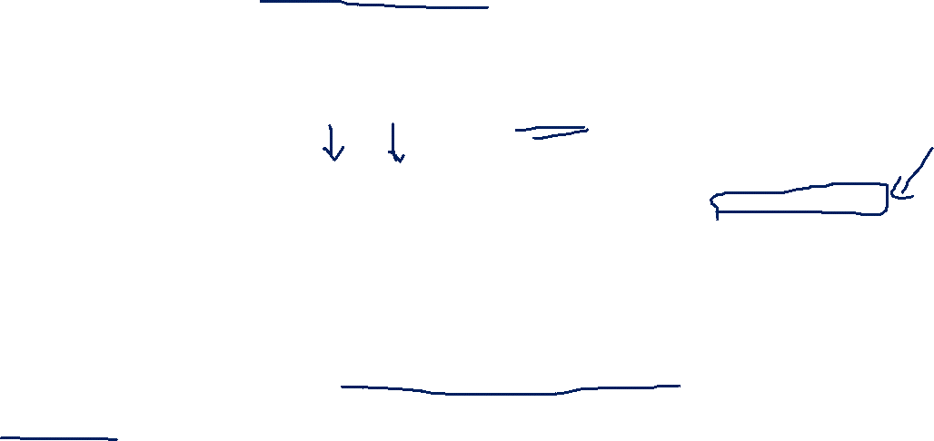
IMPLEMENTING MLP WITH KERAS
Once you are satisfied with your model’s validation accuracy, you should evaluate it on the test set to estimate the generalization error before you deploy the model to production. You can easily do this using the evalu ate() method (it also supports several other arguments, such as batch_size and sample_weight; please check the documentation for more details)
It is common to get slightly lower performance on the test set than on the validation set, because the hyperparameters are tuned on the validation set, not the test set
Remember to resist the temptation to tweak the hyperparameters on the test set, or else your estimate of the generalization error will be too optimistic.

Slide 38
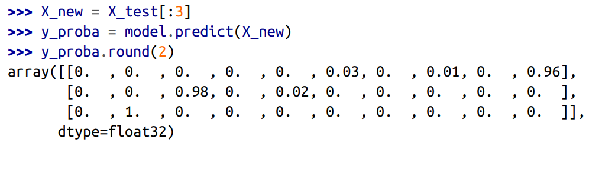
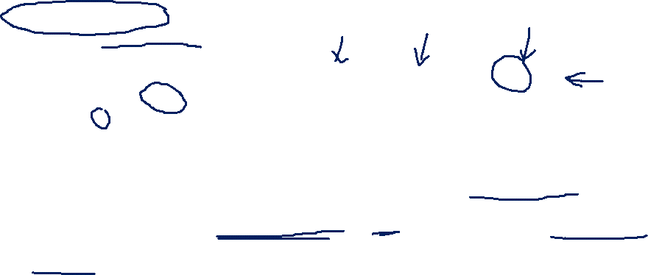
IMPLEMENTING MLP WITH KERAS
Next, we can use the model’s predict() method to make predictions on new instances. Since we don’t have actual new instances, we will just use the first three instances of the test set:
As you can see, for each instance the model estimates one probability per class, from class 0 to class 9. For example, for the first image it estimates that the probability of class 9 (ankle boot) is 96%, the probability of class 5 (sandal) is 3%, the probability of class 7 (sneaker) is 1%, and the probabilities of the other classes are negligible. In other words, it “believes” the first image is footwear, most likely ankle boots but possibly sandals or sneakers.

Slide 39



IMPLEMENTING MLP WITH KERAS
If you only care about the class with the highest estimated probability (even if that probability is quite low), then you can use the pre dict_classes() method instead:

Slide 40
HOME ASSIGNMENT – IMPLEMENT BACK PROPAGATION Example in Python Keras API
import tensorflow as tf
# Define the model
model = tf.keras.Sequential([ tf.keras.layers.Dense(1, input_shape=(1,), activation='sigmoid') ])
# Compile the model
model.compile(loss='mse', optimizer='sgd')
input_data = tf.constant([0.2]) # Training Data
target_data = tf.constant([0.8]) # Train the model
model.fit(input_data, target_data, epochs=10000, verbose=2)
# Get the final weights and biases
weights = model.layers[0].get_weights()[0][0]
bias = model.layers[0].get_weights()[1][0]
print("Final weights and biases:")
print("w1 = ", weights) print("b1 = ", bias)
Notes:
Initially, the weights of the network are assigned random values, so the network merely implements a series of random transformations. Naturally, its output is far from what it should ideally be, and the loss score is accordingly very high. But with every example the network processes, the weights are adjusted a little in the correct direction, and the loss score decreases. This is the training loop, which, repeated a sufficient number of times (typically tens of iterations over thousands of examples), yields weight values that minimize the loss function.

